Slide 1
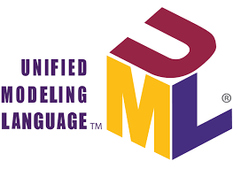
UML Building Blocks and Diagrams (UML 2.6)
UML (Unified Modeling Language) is a standard language for describing the design of software systems. As UML describes real-time systems, it is important to create a conceptual model and gradually build upon it. The conceptual model of UML can be mastered by learning the following three major elements:
A. Things :
B. Relationships
C. UML Diagrams

Slide 2
Things:
Things are the most important building blocks of UML. They can be further classified into:
Structural Things
Behavioral Things
Grouping Things
Annotational Things

Slide 3
1-1. Structural Things
Structural things define the static part of the model. They represent the physical and conceptual elements.
The structural things in UML include:
Class: Represents a set of objects having similar responsibilities.
Interface: Defines a set of operations, which specify the responsibility of a class.
Collaboration: Defines an interaction between elements.
Use Case: Represents a set of actions performed by a system for a specific goal.
Component: Describes the physical part of a system.
Node: A physical element that exists at run time.

Slide 4
1-2. Behavioral Things
Behavioral things consist of the dynamic parts of UML models. The behavioral things in UML include:
Interaction: Consists of a group of messages exchanged among elements to accomplish a specific task.
State Machine: Defines the sequence of states an object goes through in response to events.
1-3. Grouping Things
Grouping things can be defined as a mechanism to group elements of a UML model together. The only grouping thing available in UML is:
Package: Gathers structural and behavioral things.
1-4. Annotational Things
Annotational things can be defined as a mechanism to capture remarks, descriptions, and comments of UML model elements.
The only Annotational thing available is:
Note: Used to render comments, constraints, etc. of a UML element.

Slide 5
2-Relationships
Relationships show how the elements are associated with each other and describe the functionality of an application. The four kinds of relationships in UML are:
Dependency: A relationship between two things in which a change in one element affects the other.
Association: A set of links that connects the elements of a UML model, describing how many objects are taking part in that relationship.
Generalization: A relationship that connects a specialized element with a generalized element, describing the inheritance relationship.
Realization: A relationship in which two elements are connected, where one element describes some responsibility, which is not implemented, and the other one implements them (e.g., interfaces).

Slide 6
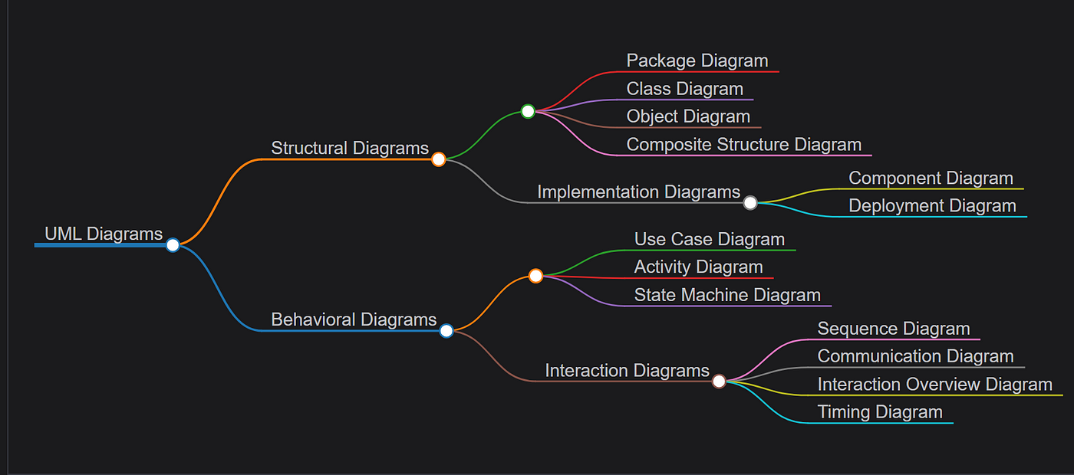
UML Diagrams

